Slide 1

Current Ratio Compared to Market Capitalization
By Michael Willis
Notes:
During this slide discuss the background of the project, I/E why it was completed – to complete the capstone project, and a background of the author – student at the university in a degree program studying data analytics.

Slide 2
Abstract
The current ratio is a measure of short-term debt and is defined as current assets divided by liabilities. Current in this case is one year or less, this is then compared to the company’s stock capitalization, or the stock price multiplied by the outstanding shares to analyze the relationship be between the two data points. This research intends to help decision makers at companies in the future adopt best practices guidelines, a tool to help financial officers stay within the boundaries of success. Furthermore, if there is a more recent change based on the great recession or the field in which the company operates.
Notes:
The current ratio is a measure of short-term debt and is defined as current assets divided by liabilities. Current in this case is one year or less, this is then compared to the company’s stock capitalization, or the stock price multiplied by the outstanding shares to analyze the relationship be between the two data points. This research intends to help decision makers at companies in the future adopt best practices guidelines, a tool to help financial officers stay within the boundaries of success. Furthermore, if there is a more recent change based on the great recession or the field in which the company operates.
In previous research there have been mixed findings, some define that there is a relationship between the two variables in a positive nature but was narrow in its study. Other broader studies imply that there should be very little or detailed study of the two variables independently and that using summary data would have ill effects.
Using the data made available by the NASDAQ exchange the author found that there is little to no correlation over time using a Pearson correlation analysis as well as a linear regression and scatter plots that yielded inconclusive results, and that there has been little change over the last decade. It is important to note that the current ratio has increased over time, and more research should likely be conducted as to the growth of the ratio over the course of time and what impact that has had on the economy.
Keywords: Current Ratio, NASDAQ, Market Capitalization, Pearson

Slide 3
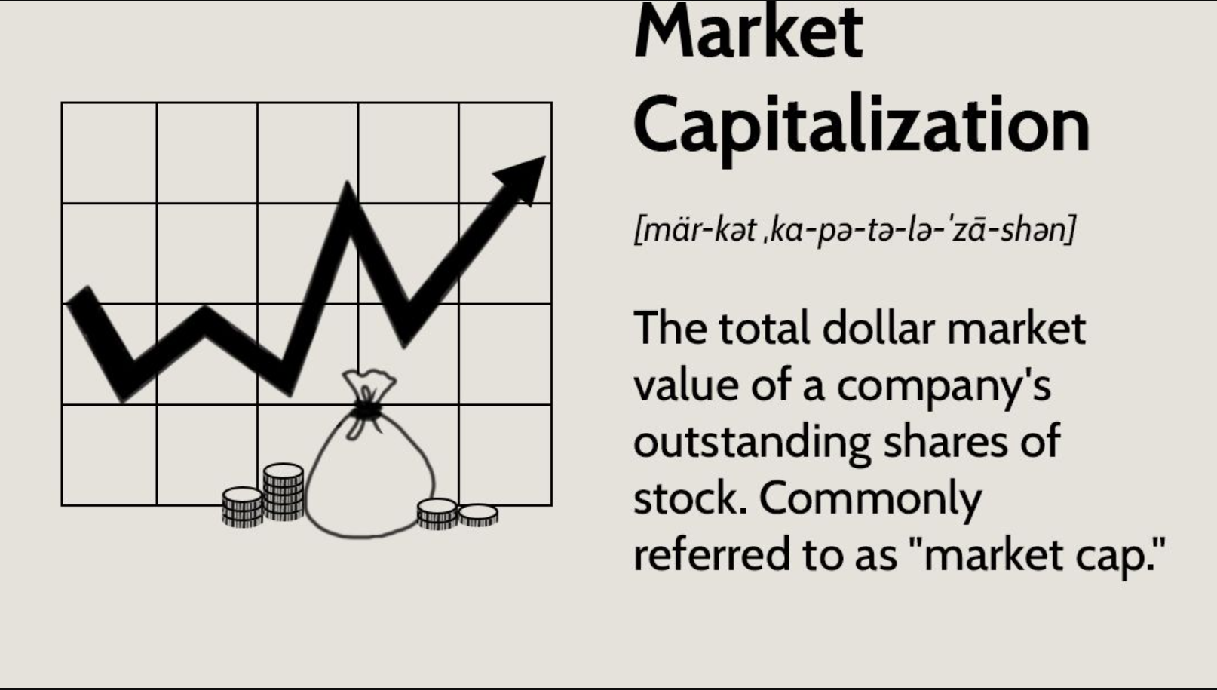
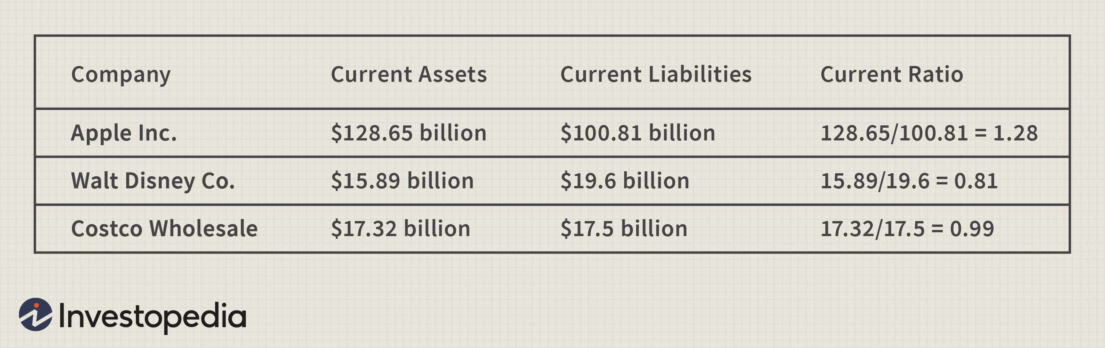
Introduction
- What is the current ratio?
- What is Market Capitalization?
- Relationship
- Value of Research
- Objective of Research
Notes:
Current Ratio is the current assets over the current liabilities
“Current” means due in the next year and is a GAAP measurement (Generally Accepted Accounting Principals)
Market Capitalization is stock price multiplied by outstanding shares - Much better than simply reviewing price as there are items that are not related to the overall value that may change price – splits.
What is a correlation, how would we expect it to be in line
Help management decision making – provide guidelines for future investments
Establish a benchmark and see if things have changed over the last decade where interest rates were at historical lows.
Investopeida

Slide 4
Research question(s)
RQ1: Has the last decade of low interest rates that followed a deep recession embedded in debt changed the overall investing patterns for stocks traded on the secondary market, or do the trade relatively like historical results?
RQ2: To elaborate on RQ1, is there any dependency on the field the company operates in, or said differently do companies traded on the NASDAQ, which tend to be technology in nature, differ from those traded on other exchanges or fields?

Slide 5
Hypotheses
H10: Short term trends in borrowing and their relationship to stock prices have not changed in the last decade. H1A: Short term trends as measured by the Current ratio have changed over the last decade.
H20: The field that the company is in has no effect on the influence of the current ratio on stock price. H2A: The field is a company operates influences the price when factored with the current ratio of the company.
H20: The relationship quantified in H2 is historically stable and has not changed over the last decade. H2A: The relationship quantified in H2 does change over time and has change in a statistically significant manner over the past decade.

Slide 6
Aims and Objectives
- Correlation between Current Ratio and Market Capitalization
- Help Decision Makers
- Reduce Costs
- Provide guidelines for borrowing
- Assess investment opportunities

Slide 7
Background
- Management decisions to take out loans
- Investment of idle cash
- Moody’s Ratings
- Increases in stock prices
- Housing crisis and abnormal interest rates for decade

Slide 8

Literature Review
- Study in Sri Lanka
- Study in India
- Reinhart–Rogoff
- Emerging Markets
- Historical Context
Notes:
- Manufacturing companies in sri Lanka found that there was a positive result by being more liquid, taking risk at a higher leverage was not ideal
Study in india technology companies found a similar result in the field of technology, companies that typically have higher research costs and borrow at higher rates
Why not to use excel, effect of debt on GDP
Are emerging markets different than more established markets?
It has been mention that these ratios are nice on their own, but that one has to look at a more holistic view of each company rather than assuming things based simply on one ratio or another.

Slide 9


Research Design/Approach
- Data from Nasdaq Data Link Website
- Manipulation completed in Python 3
- Types of Tests used
Correlations
Linear Regression
Grouping and subsections
Years and subsections

Slide 10

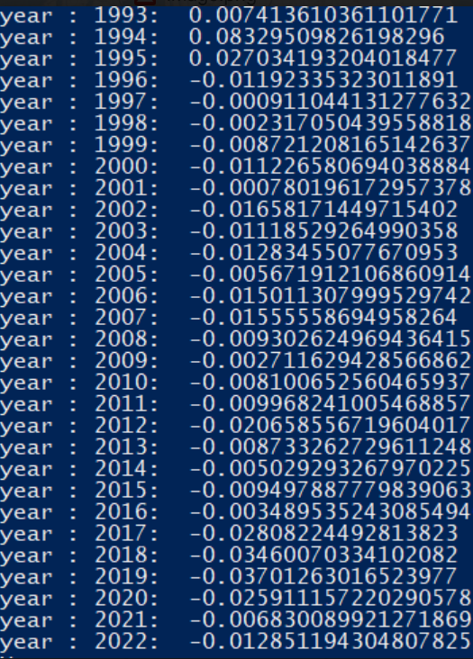
Findings
- Singular result on overall data
- Values over time
- Values by Segment
- Outliers

Slide 11
Conclusion
- Acceptance of Null Hypotheses
- Meaning of acceptance
- Future Research
- Comparison to research
- Future Questions

Slide 12
References
Nasdaq, Inc. (2022). Nasdaq Data Link. https://www.nasdaq.com/nasdaq-data-link
Suryana, N., & Anggadini, S. D. (2020, November 10). Analysis of Stock Prices Affected by Current Ratio. International Journal Of Science, Technology & Management. https://ijstm.inarah.co.id/index.php/ijstm/article/download/44/30/
Reinhart, Carmen M, and Kenneth S Rogoff. 2010. Growth in a time of debt. American Economic Review 100, no 2: 573-578.
Hakkı Öztürk & Tolun A. Karabulut. 2018. The Relationship between Earnings-to-Price, Current Ratio, Profit Margin and Return: An Empirical Analysis on Istanbul Stock Exchange. Accounting and Finance Research. Vol 7 (1). 109-115.
Richards, B. (2014, January 6). Why great CEOs ignore their company's stock price. The Motley Fool. https://www.fool.com/investing/general/2014/01/06/why-great-ceos-ignore-their-companys-stock-price.aspx
Quick ratio. (2022). Macrotrends | The Long-Term Perspective on Markets. https://macrotrends.net/definitions/terms/quick-ratio/
Current ratio definition. (2003, November 19). Investopedia. https://www.investopedia.com/terms/c/currentratio.asp

